Slide 1
Chapter 3: Requirements Determination

Slide 2
Learning Objectives
Learn how to gather requirements using interviews, JAD sessions, questionnaires, document analysis & observation
Understand when to use each requirements-gathering technique

Slide 3
Requirements Gathering Techniques
Process is used to:
Uncover all requirements (those uncovered late in the process are more difficult to incorporate)
Build support and trust among users
Which technique(s) to use?
Interviews
Joint Application Development (JAD)
Questionnaires
Document analysis
Observation

Slide 4
Interviews
Most popular technique—if you need to know something, just ask
Process:
Select people to interview & create a schedule
Design interview questions (Open-ended, closed-ended, & probing types of questions)
Prepare for the interview (Unstructured vs. structured interview organized in a logical order)
Conduct the interview (Top-down vs. bottom-up)
Follow-up after the interview

Slide 5
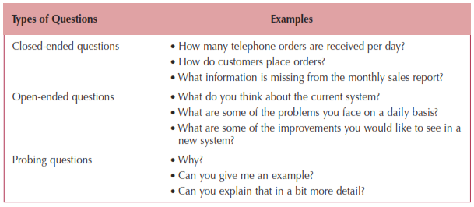
Question Types

Slide 6
Interviewing Strategies
Top-down
How
can order
processing be
improved?
High-level:
Very general
Medium-level:
Moderately specific
How can we reduce the
number of times that customers
return ordered items?
Low-level:
Very specific
How can we reduce the number of
errors in order processing (e.g., shipping
the wrong products)?
Bottom-up

Slide 7
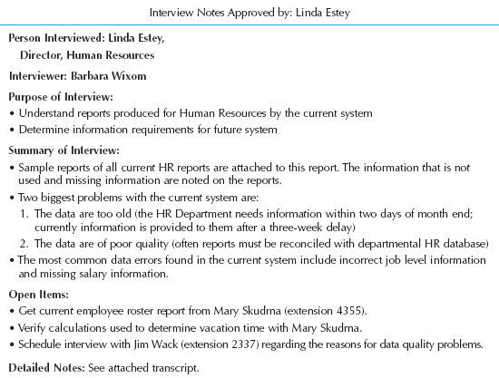
Post-Interview
Prepare notes and send to the interviewee for verification

Slide 8
Joint Application Development (JAD)
Joint user-analyst meeting hosted by a facilitator
10 to 20 users
1 to 2 scribes as needed to record the session
Usually in a specially prepared room
Meetings can be held electronically and anonymously
Reduces problems in group settings
Can be held remotely
Sessions require careful planning to be successful
Users may need to bring documents or user manuals
Ground rules should be established

Slide 9
Questionnaires
A set of written questions used to obtain information from individuals
May be paper based or electronic (e.g., web based)
Common uses:
Large numbers of people
Need both information and opinions
When designing for use outside the organization (customers, vendors, etc.)
Typical response rates: < 50% (paper); < 30% (Web)

Slide 10
Questionnaire Steps
Select the participants
Identify the population
Use representative samples for large populations
Designing the questionnaire
Careful question selection
Remove ambiguities
Administering the questionnaire
Working to get good response rate
Offer an incentive (e.g., a free pen)
Questionnaire follow-up
Send results to participants
Send a thank-you

Slide 11
Good Questionnaire Design
Begin with non-threatening and interesting questions
Group items into logically coherent sections
No important items at the very end
Do not crowd a page with too many items
Avoid abbreviations
Avoid biased or suggestive items or terms
Number questions to avoid confusion
Pretest to identify confusing questions
Provide anonymity to respondents

Slide 12
Document Analysis
Provides information about the “as-is” system
Review technical documents when available
Review typical user documents:
Forms
Reports
Policy manuals
Look for user additions to forms
Look for unused form elements

Slide 13
Observation
Users/managers often don’t remember everything they do
Checks validity of information gathered in other ways
Behaviors may change when people are watched
Workers tend to be very careful when watched
Keep a low profile
Try not to interrupt or influence workers
Be careful not to ignore periodic activities
Weekly … Monthly … Annually

Slide 14
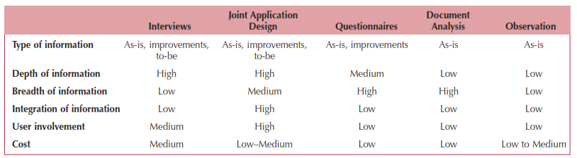
Requirements-Gathering Techniques Compared
A combination of techniques may be used
Document analysis & observation require little training; JAD sessions can be very challenging

